Slide 1



Primary Care Glove Reduction Training
Based on the NWICB IP&C June 2024
By Ian Vinall

Slide 2

A
Aims and Objectives
Aims
The aim is to remind staff when it is appropriate to wear gloves and when glove use is not required.
Objectives
Remind all staff when it's appropriate to wear and not wear gloves.
Re educate staff and patients perceptions around what is appropriate glove use.
Improve long term sustainability.
Reduce the impact that over reliance on glove use has, on waste generated, the environment and Practice spend.

Slide 3


Why look at glove use now?
The Covid19 pandemic generated numerous guidance changes around
the use of PPE, with gloves being used for most interactions with patients.
Following the Governments Living with Covid guidance May 2022, we have
moved to Covid19 being part of business as usual.
Now is the time to reset the correct message about when gloves
should be worn.
This will help prevent inappropriate and overuse of gloves, reduce cost
and waste generated.

Slide 4
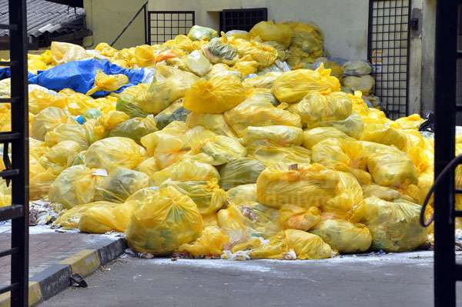
Background
The NHS generates approximately 150 million tonnes of plastic waste, which has a huge environmental impact.
The use of gloves in clinical and non-clinical areas are a main contributor to this plastic waste.
The NHS in England accounts for approximately 4% to 5.4% of total UK carbon emissions, making it a major public sector emitter.
Progress: As of 2024, the NHS has reduced direct emissions by 68% since 1990.
Notes:
150 million tonnes equates to 22 million elephants
22 million African elephants end to end would stretch 7 times Pole to Pole

Slide 5



The Lifecycle of Gloves
This 2-minute video shows the whole journey of gloves from production in Asia through to disposal.
Notes:
https://www.youtube.com/watch?v=y9igNr-rtJs
As we have seen the glove journey is more than just about cost savings for the practice. It includes---
Social and ethical employment practices throughout the whole supply chain from production, transport, distribution and supply. Many gloves are made in developing countries where employees are vulnerable to abuse of labour rights and working conditions.
Fossil fuel extraction-nitrile gloves originate from oil and are therefore a fossil fuel derivative.
Use of natural resources- the manufacture of gloves is dependent on the use of large volumes of water which can result in local shortages for those living near factories.
Pollution- chemicals used in glove production can contaminate local water courses and the environment.
Lengthy transportation- transporting gloves from manufactures to their place of use requires significant use of transport such as boats air and road transportation, all of which have implications for use of fossil fuels and pollution.

Slide 6
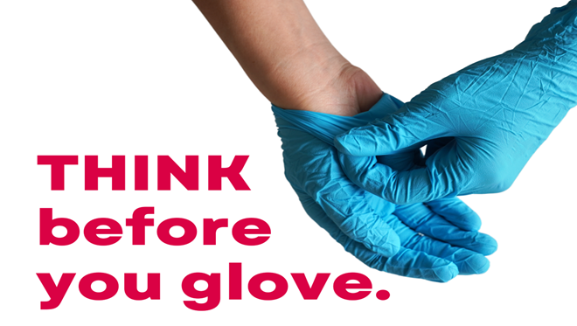
Environmental Impact
Medical examination and surgical gloves are single-use items and represent one of the largest categories of non-recyclable waste in the healthcare sector.
While single-use gloves are an essential measure for protecting both staff and patients, their environmental impact is significant.
We can all help reduce this impact by using gloves appropriately and avoiding unnecessary or habitual use.

Slide 7
Changing Perceptions
Patients' expectations that staff should wear gloves has increased post pandemic.
Research has shown that nurses and other health care professionals wear gloves because they think it protects their patients in some way.
Staff feel protected and can then forget to undertake hand hygiene when it is indicated in accordance with the 5 moments.
Gloves are not a substitute to good hand hygiene.
Hand hygiene is one of the most highly effective ways of protecting staff and patients and this can often be forgotten when staff are wearing gloves.
Notes:
Staff feel protected—the wearing of gloves when not required ie, when there is no exposure to blood or body fluids is anticipated, will impact on efforts to reduce climate change, waste financial resources and undermine hand hygiene efforts to improve IPC practices. Self protection can be a key driver for use of gloves when not clinically indicated. We have forgotten the ability to trust our own skin, hands are waterproof. Post covid there is a fear of other organisms, Mpox, TB, etc, we have lost the ability to make own risk assessments, easier to just wear gloves. I will wear gloves just in case. For some new staff who trained during the Covid19 pandemic, this level of PPE and being wrapped in plastic is all they have known.
Patients' perceptions—patients observe practice and formulate their own views on compliance and appropriateness of what constitutes good practice. Tasks that make them feel uncomfortable do not necessarily align with recommendations for glove use. It is about re education of patients and staff perceptions in a post covid19 world.

Slide 8
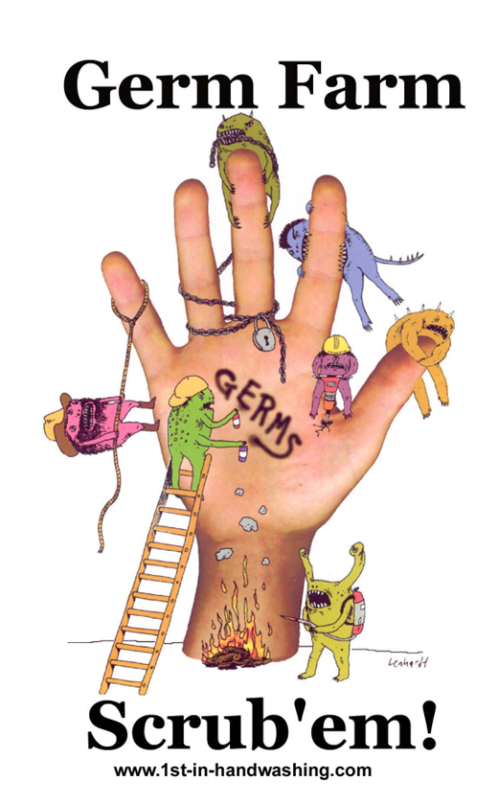
Hand Hygiene
Hand hygiene is essential to reduce the transmission of infection.
All staff and visitors should decontaminate their hands with an alcohol-based hand rub when entering and leaving the practice.
Clinical staff must be bare below the elbow, plain band wedding ring worn only, no false nails / nail varnish etc.
Undertake hand hygiene when it is indicated in accordance with the 5 moments.

Slide 9
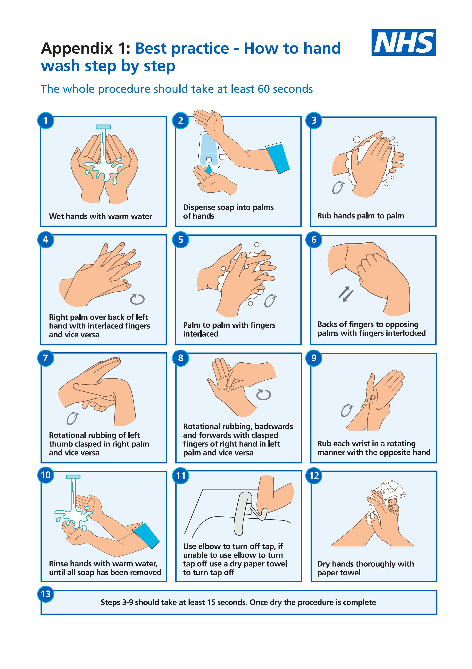
Hand Hygiene:
You should wash your hands for the time it takes to sing "Happy Birthday" twice (around 20 seconds)

Slide 10
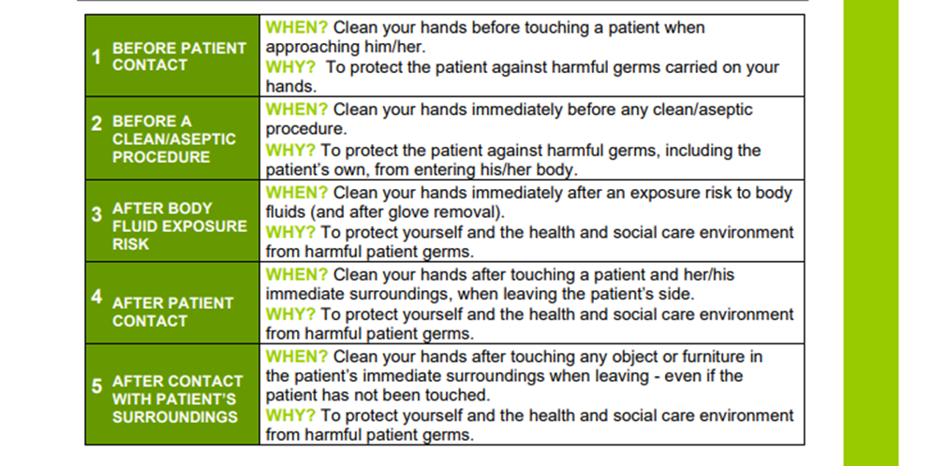

Your 5 moments for Hand Hygiene at the point of care

Slide 11


Hand Hygiene
Notes:
https://www.youtube.com/watch?v=2TRAVbNqE4E

Slide 12
Contact Dermatitis
Wearing gloves inappropriately or for long periods of time can cause skin problems.
If hand hygiene is not done or incorrectly done it can increase the risk of dermatitis.
Regular use of conditioning creams and emollients should be encouraged after hand washing.
Notes:
Staff feel protected—the wearing of gloves when not required ie, when there is no exposure to blood or body fluids is anticipated, will impact on efforts to reduce climate change, waste financial resources and undermine hand hygiene efforts to improve IPC practices. Self protection can be a key driver for use of gloves when not clinically indicated. We have forgotten the ability to trust our own skin, hands are waterproof. Post covid there is a fear of other organisms, Mpox, TB, etc, we have lost the ability to make own risk assessments, easier to just wear gloves. I will wear gloves just in case. For some new staff who trained during the Covid19 pandemic, this level of PPE and being wrapped in plastic is all they have known.
Patients' perceptions—patients observe practice and formulate their own views on compliance and appropriateness of what constitutes good practice. Tasks that make them feel uncomfortable do not necessarily align with recommendations for glove use. It is about re education of patients and staff perceptions in a post covid19 world.

Slide 13

Gloves: To wear or not to wear; that is the question?
Notes:
We are not saying gloves should never be worn, because there are clinical and non clinical interventions that still require gloves to be worn. But, we need to look at our own glove wearing and question why am I wearing them, is it required for the task or is it that I feel safer wearing them.

Slide 14
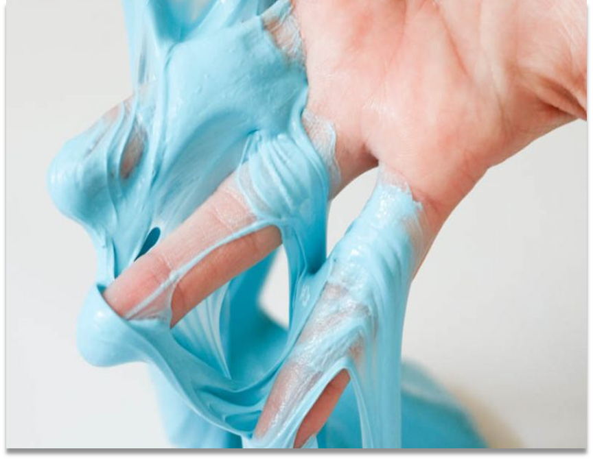
If it’s wet or sticky and doesn’t belong to you wear gloves!
When to wear gloves:
Contact with blood and /or body fluids.
Substances hazardous to health, ie cleaning/disinfecting products.
Non-intact skin or mucous membranes.
Patient has a confirmed or suspected infection
Notes:
See Harrogate Policy 13 for glove selection

Slide 15
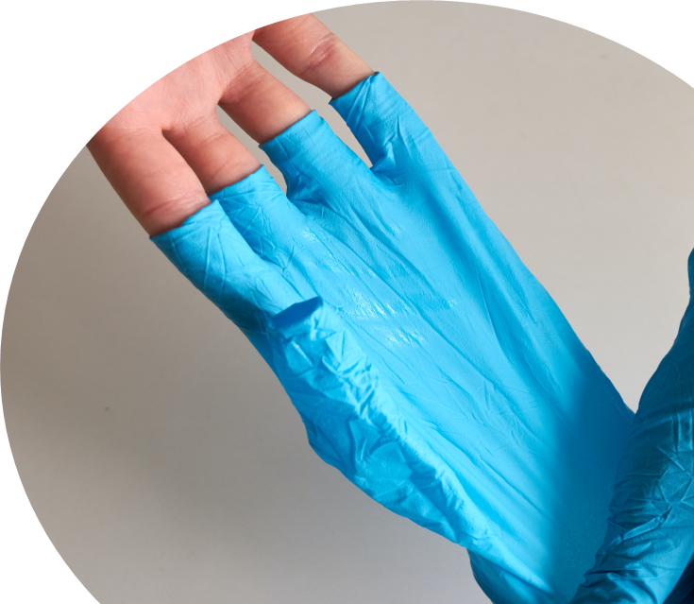
Gloves Off!
Taking a patient's height and weight.
Taking a patient’s pulse and temperature.
Taking a patient's blood pressure using a manual or automatic
blood pressure machine.
Checking and cleaning the Resus trolley.
Drawing up non cytotoxic medications for injection.
Administering non cytotoxic medications via injection.
Notes:
Gloves are not necessary when giving routine injections as long as hand contact with blood or other potentially infectious material is not anticipated.
If bleeding is anticipated and the employee is required to clean the site following injection, then gloves must be worn.

Slide 16

Will my changes make a difference?
Each glove costs approximately £0.062
If 5 pairs of gloves are no longer used, a saving of £0.62 per day will be made.
Saving £3.10 over a week (Mon-Fri)
Saving £161.20 over a year on cost spend to your Practice.
This will also reduce waste generated by your Practice of:-
5 pairs of Gloves per day
25 pairs of gloves per week
1300 pairs of gloves per year
Notes:
Calculations based on £6.20 for a box of 100 of non-sterile gloves. Note – sterile gloves cost approx. £26 for a box of 50 pairs.
Small changes will make a big difference; the savings are from only reducing glove use by 5 pairs of gloves. If everyone in your Practice reduced glove use by 5 pairs a day, the cost and waste generated will start to snowball. Gloves are no longer free from the online NHS PPE Portal, its back to pre pandemic status with your own Practice having to buy gloves. We can all make a difference however small to your overall Practice purchase costs and waste generated.

Slide 17
Wider Cost Savings
There are 55 GP Practices in Cornwall & Isles of Scilly. If each practice reduced glove use by 5 pairs a day:
275 pairs of gloves not used daily.
1,375 pairs of gloves not used weekly.
71,500 pairs of gloves not used yearly.
Cost saving of £161.20 X 55 Practices = £8,866
Or 1,430 boxes of gloves not required, reducing cost, transportation, manufacture and waste disposal, all from making just one small change.
TAKE 5 - GIVE GLOVES A REST
Notes:
Gloves are not necessary when giving routine injections as long as hand contact with blood or other potentially infectious material is not anticipated.
If bleeding is anticipated and the employee is required to clean the site following injection, then gloves must be worn.

Slide 18
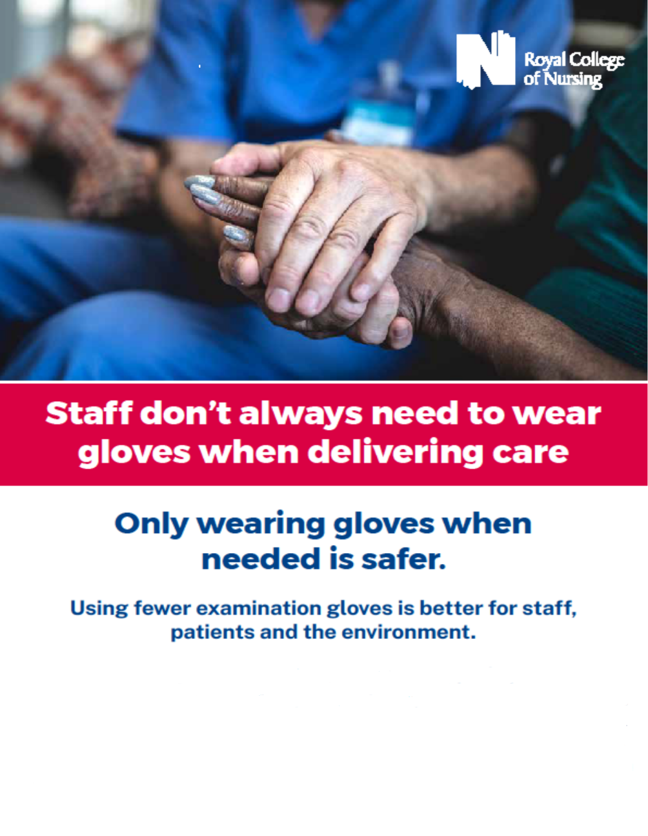
Thank you
Adapted for Cornwall & Isles of Scilly by
Annette Eatock, Primary Care Climate Resilience Team
annettee@volunteercornwall.org.uk
www.healthandclimate.org.uk

