Slide 1





CORNWALL
Introductions (& record)
Gloves Reduction in Primary Care
Online resources – new website
Blister Pack recycling
Annette Eatock
Climate Resilience Project Officer, West Cornwall
& Waste and Recycling Lead
Notes:
Introductions

Slide 2


Gloves Reduction: the story so far
IPC visiting speakers to Waste Watchers in Jan.
Follow up meeting with Trudi Isherwood (NHSE), Honey Smith (Greener Practice), & Ian Vinall (IPC Norfolk & Waveney)
Presentation at ‘Supporting General Practice’ meeting.
Seven practices in Cornwall (so far) interested in Glove Reduction Pilots
Notes:
Later slides will cover the QI project from N&W. Big thanks to Ian Vinall.
Penryn – first to do questionnaire.

Slide 3

Why look at glove use now?
Glove use rose through the Covid 19 Pandemic, with gloves used for most interactions with patients.
Infection Prevention & Control (IPC) can reset the correct message about when gloves should be worn.
Every year the NHS uses 1.7 billion nitrile gloves, costing 48 million pounds.
There is also the cost of disposal, which is often in high temperature incineration in Clinical Waste streams.
Notes:
Show waste resources on website.

Slide 4
Glove Reduction in Primary Care
Background
Glove reduction programmes spread from hospital trusts into primary care and care homes. The N&W ICB IPAC team ran a pilot across 3 Norfolk GP Practices from July to Sept 2023.
Aim of programme
Improved staff and patient experience
Prevention of inappropriate glove use associated infection risks
Reduction in spend on gloves
Reduction in waste and positive environmental impact
Cost reduction in waste removal
Notes:
Recycling costs a third less than general waste

Slide 5
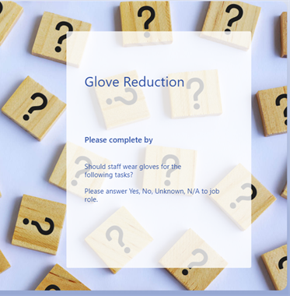
Pilot Process
Development of an online staff questionnaire to establish current behaviours of appropriate glove use
Questionnaire was completed by all disciplines of staff within each practice including clinical and non clinical staff over a 2 week period
Data for each practice correlated by ICB IPAC team
An appropriate glove use training package was delivered to all staff within each practice by ICB IPAC team
The same questionnaire was given to staff after the 3 month pilot to evaluate if behaviours had changed

Slide 6
Pilot Results (in N&W)
The post pilot questionnaire data showed that staff perceptions of correct glove use had significantly improved.
This change has been seen in all 3 practices (West, Norwich, North )
Examples of when gloves were being worn inappropriately prior to the pilot include:
- when taking a patient’s pulse or blood pressure or temperature
- when typing on a keyboard
- when giving a vaccine
when taking a patient’s weight
One practice reported a 4500 glove reduction usage during the 3-month pilot period.
£216 saved, 22.5 boxes gloves saved, 117,000g (CO2e) reduction in carbon emissions saved.

Slide 7
Changing Perceptions
Patients' perceptions and expectations that staff should wear gloves has increased post pandemic.
Research has shown that nurses and other health care professionals wear gloves because they think it protects their patients in some way.
Staff feel protected and can then forget to undertake hand hygiene.
Gloves are not a substitute to good hand hygiene.
Hand hygiene is one of the most highly effective ways of protecting staff and patients and this can often be forgotten when staff are wearing gloves.
Notes:
Staff feel protected—the wearing of gloves when not required ie, when there is no exposure to blood or body fluids is anticipated, will impact on efforts to reduce climate change, waste financial resources and undermine hand hygiene efforts to improve IPAC practices. Self protection can be a key driver for use of gloves when not clinically indicated. We have forgotten the ability to trust our own skin, hands are waterproof. Post covid there is a fear of other organisms, Mpox, TB, etc, we have lost the ability to make own risk assessments, easier to just wear gloves. I will wear gloves just in case. For some new staff who trained during the Covid19 pandemic, this level of PPE and being wrapped in plastic is all they have known.
Patients perceptions—patients observe practice and formulate their own views on compliance and appropriateness of what constitutes good practice. Tasks that make them feel uncomfortable do not necessarily align with recommendations for glove use. It is about re education of patients and staff perceptions in a post covid19 world.

Slide 8
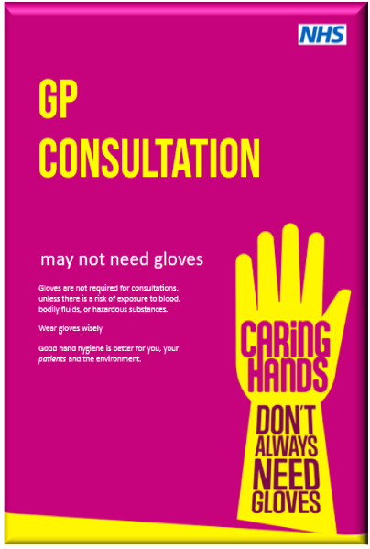
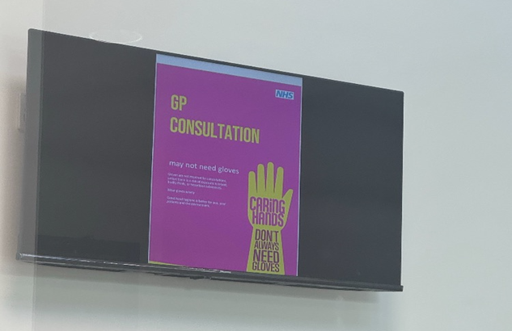
Glove Reduction Resources
Notes:
I’ve got access to all the resources to run a similar pilot in Cornwall – questionnaire, training package, posters etc.
I’m in touch with the CIoS IPC team & are looking for practices that are keen to take part.
Free to download and use.
Amendable Logo to reflect settings use.
40 Posters, Screen savers and patient electronic waiting room versions available.

Slide 9

Primary Care Glove Reduction in Cornwall & Isles of Scilly
Questionnaire 1: Send the Glove Use Questionnaire to all staff with deadline (suggested two weeks or less).
Training: Complete the Primary Care Glove Reduction Training – using the PowerPoint.
Display posters: for both staff and patients. These can be edited and bespoke to your practice.
Questionnaire 2: Send the Glove Use Questionnaire again to compare usage from before the training.
Procurement Data: Compare orders of gloves before the training to afterwards.
Email annettee@volunteercornwall.org.uk for more info and resources.
Notes:
Training can be done in small teams or departments, or as part of a whole practice closure day.

Slide 10
Primary Care Glove Reduction in Cornwall & Isles of Scilly
The story so far:
Seven GP practices expressed interest.
Two have completed the first questionnaire & training.
Positive feedback.
NHS Southwest Peninsula ICB Green Plan 2025- 2030 – adopted in Oct 2025. Commits to: ‘1. Reduce environmental impact’
Notes:
NHSE info from : https://www.england.nhs.uk/long-read/five-years-greener-nhs-progress-forward-look/
Trudi Isherwood shared this - Regional Net Zero Manager

Slide 11
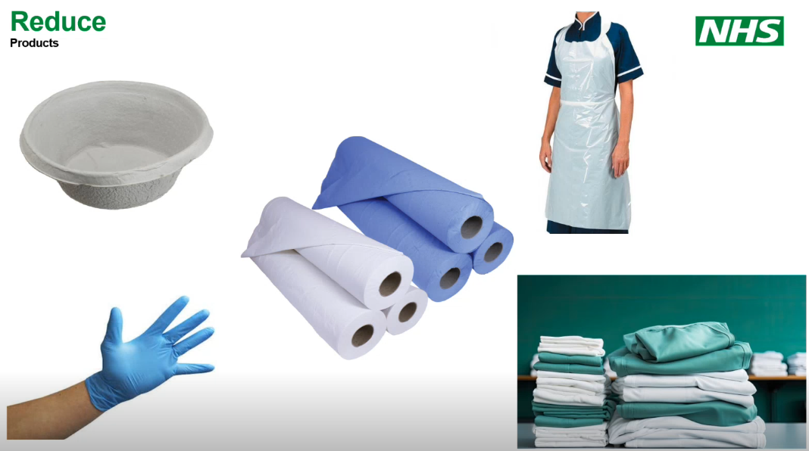
Glove use reduction is in the Top Ten Easy Wins list from NHSE:
Notes:
Questions? Thoughts? Volunteer practices? – Port Isaac & Narrowcliff (Newquay) – need one in the West ICA?

Slide 12


Waste & Recycling Resources
New website: www.healthandclimate.org.uk
Resources section: www.healthandclimate.org.uk/resources
Notes:
Show waste resources on website.

Slide 13
Blister Pack Recycling
Recycling is always a popular topic. Remember ‘Reduce & Reuse’ first!
Blister packs – fit into the ‘hard to recycle’ category.
Superdrug – very few stores that accept recycling in Cornwall.
Boots – long winded and technical process.
Other options?

Slide 14
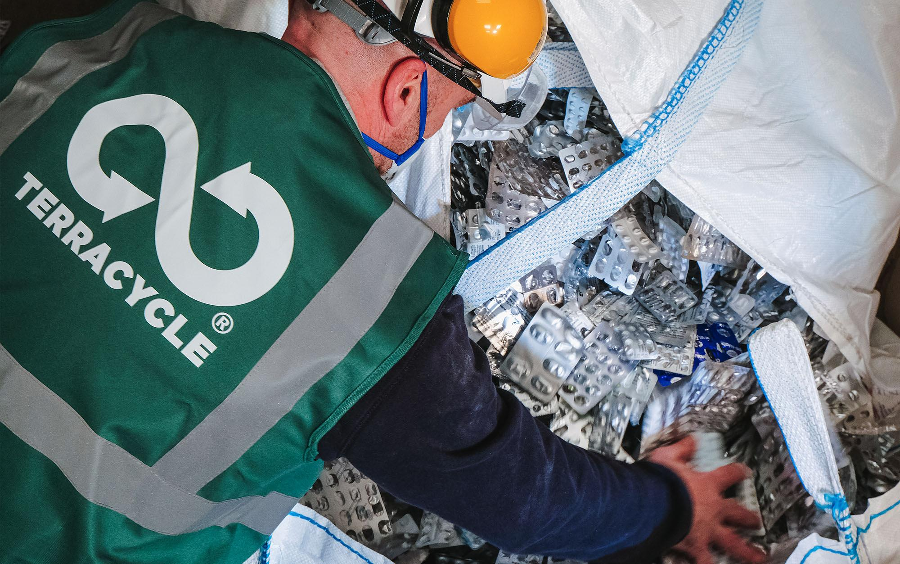
Blister Pack Recycling
Paid for services:
Terracycle
£100 for small (1500 blister packs) - £216 (7500).
Video on how they recycle online.
Video Link
Notes:
Terracycle – separate aluminium from plastic & ‘made into new products’ – lack details. https://vimeo.com/941531231/f7e6e80119

Slide 15
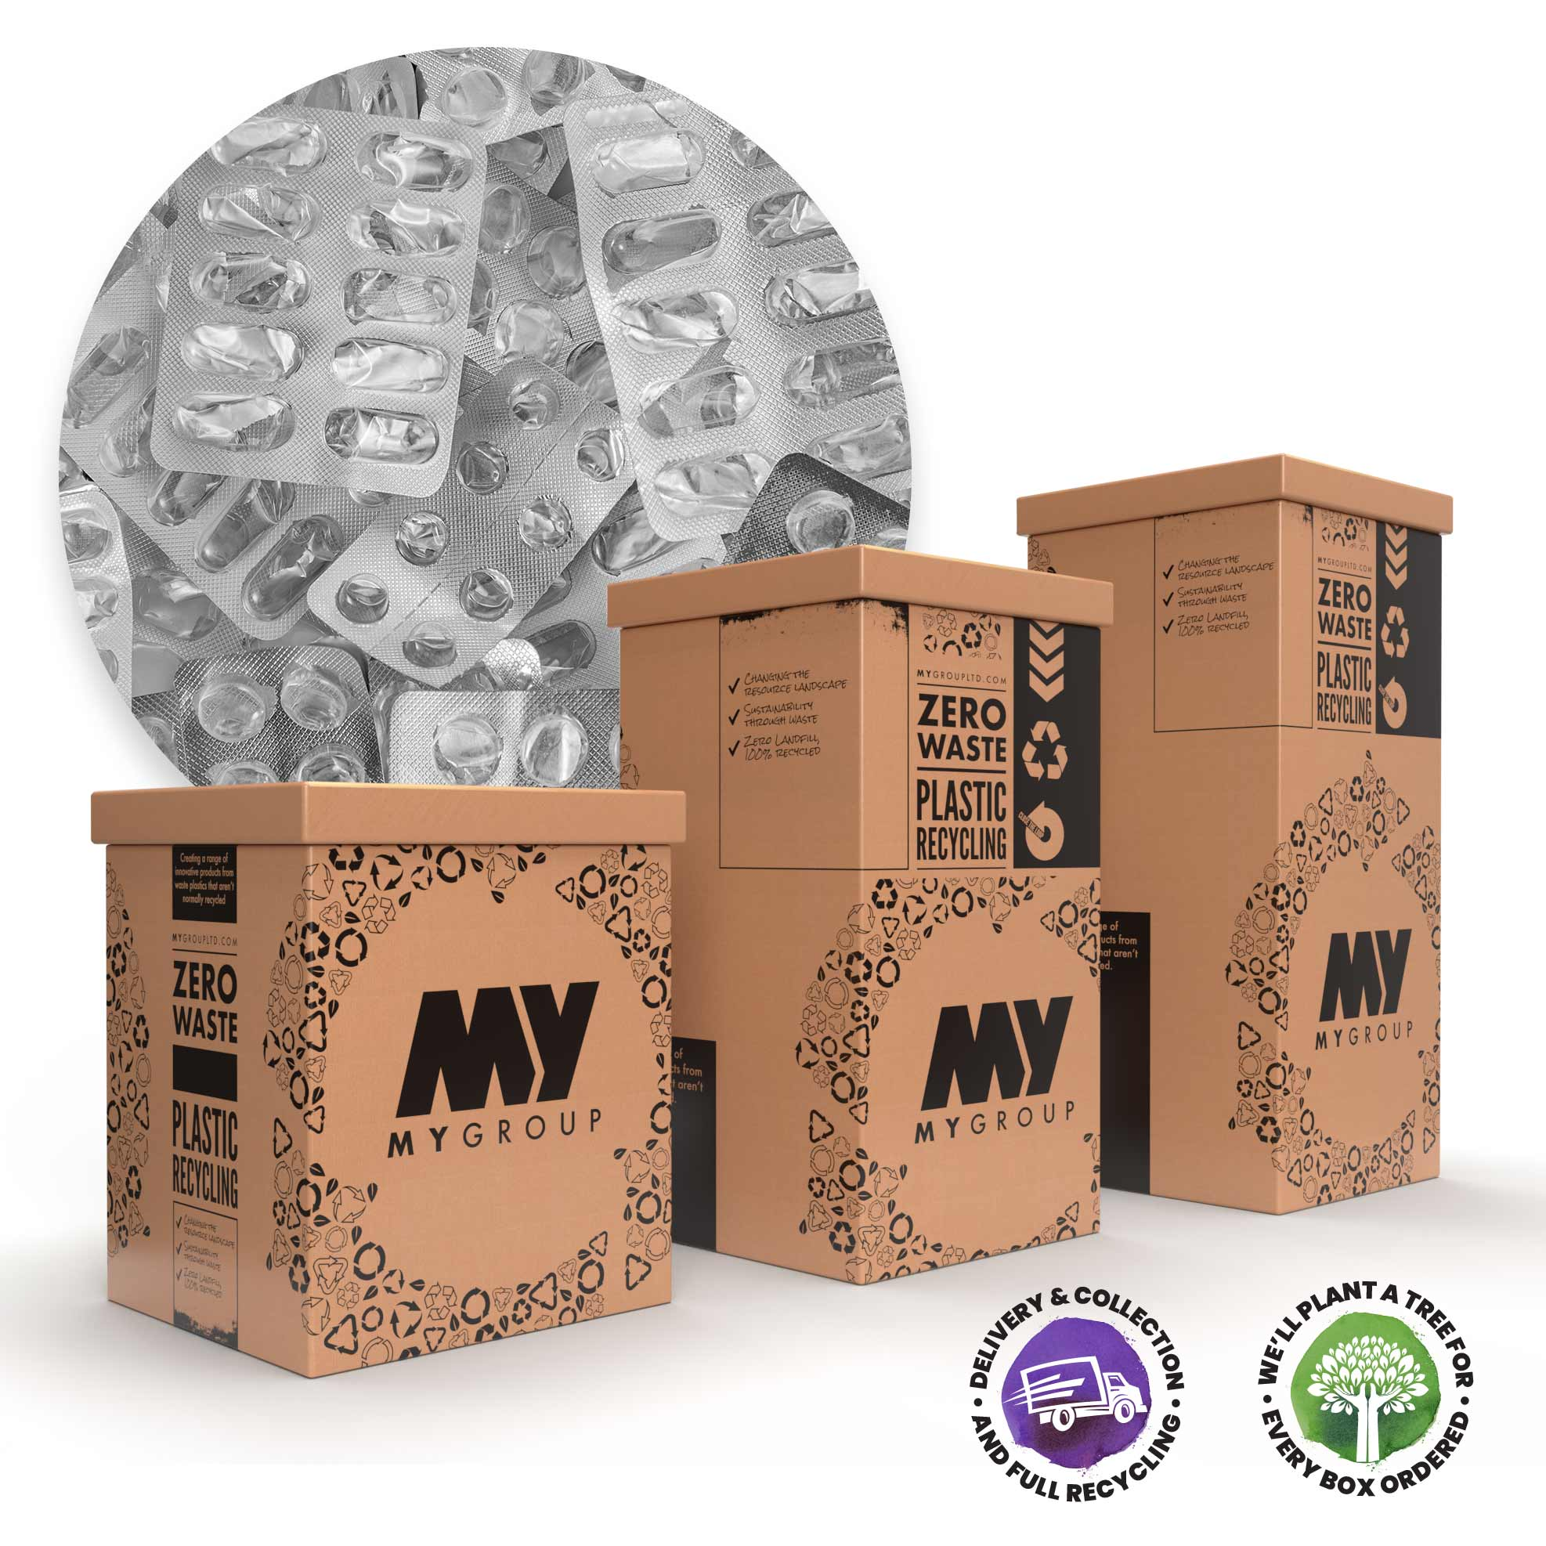
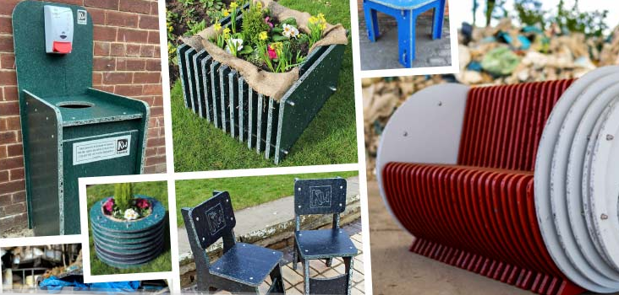
Blister Pack Recycling
Paid for services:
Refactory / MY Group
£76 for 60L box - £112 for 110L box
Includes collection when full.
Process the plastic into a board that is used as an alternative to plywood.
Notes:
MyGroup (based in Leeds) – plastic is recycled into board that is an alternative to plywood e.g. can be made into furniture.
https://mygroupltd.com/plastic-boards/

Slide 16



Future meetings?
Next time: Tues 15th Sept 12.30pm
More topic suggestions…..?
Contact:
annettee@volunteercornwall.org.uk
07849 086510

